Slide 1
Covalent substances

Slide 2

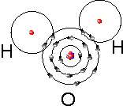
hydrogen
water

Slide 3
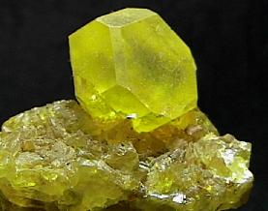
Sulfur – S₈ Italy

Slide 4
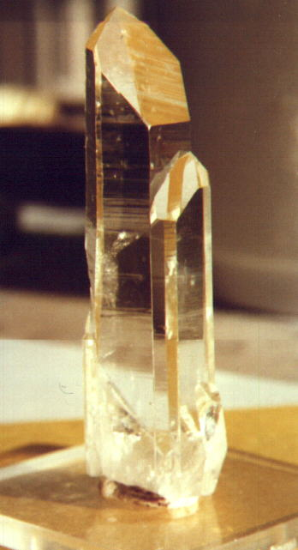
Quartz
Europe

Slide 5
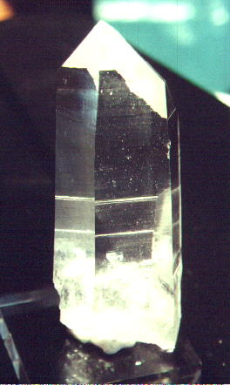
Quartz usa

Slide 6
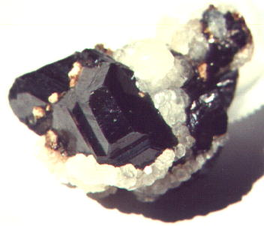
Sphalerite - Yugoslavia

Slide 7
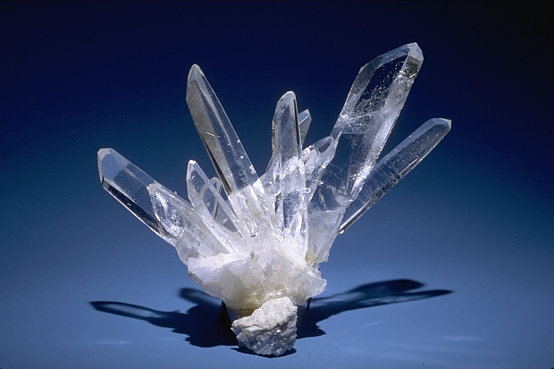

Slide 8
